Slide 1

Online Cash and Carry
Syed Raza Abbas Rizvi 200656
Submitted to: Sir Ahsan Shehzad

Slide 2

Introduction:
About
User Can:
Buy Product of his choice easily at best price and quality.
Having membership

Slide 3

Inspiration
Order From Home
All Products At One Place
Keep Track Record
Users can easily order items online by staying at home.
By having products at one place3 user don’t have to switch different shops to buy all items of list.
User can keep track of all items he have bought in whole month.

Slide 4

PROJECT OVERVIEW
Different Sections
MEMBERSHIP
Provide multiple items at one place.
Membership can allow user enjoy more discount.
User FRIENDLY
System is so much easy to use.

Slide 5
Methodology
Functional PROGRAMMING
IRVINE
If ELSE
LOOPS

Slide 6
INPUTS/OUTPUTS
SECTION
ITEMS
MEMBRESHIP
MEMBERSHIP PASSWORD
BILL DISPLAY
PAYMENT
CASH RETURNED

Slide 7

SUMMARY
This online cash and carry is very easy to use. It’s main purpose is to provide user each product at one place with best price and quality. There are three different sections Grocery, Stationary and vegetable area which allows user to buy products by staying at their home.
summary

Slide 8
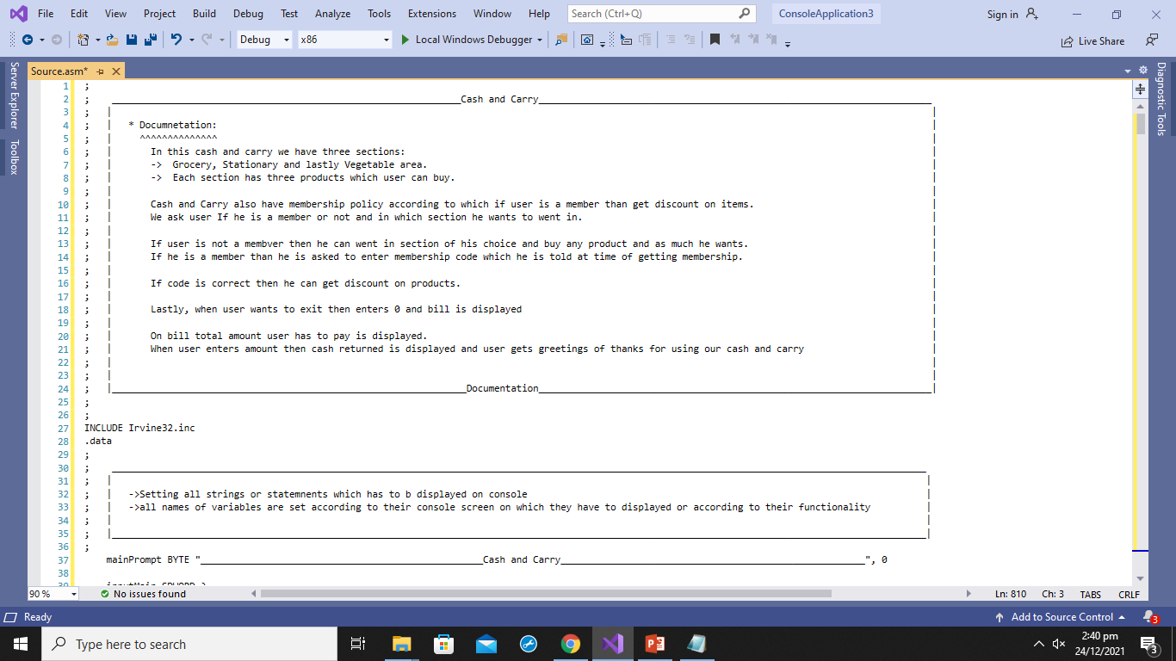

Slide 9

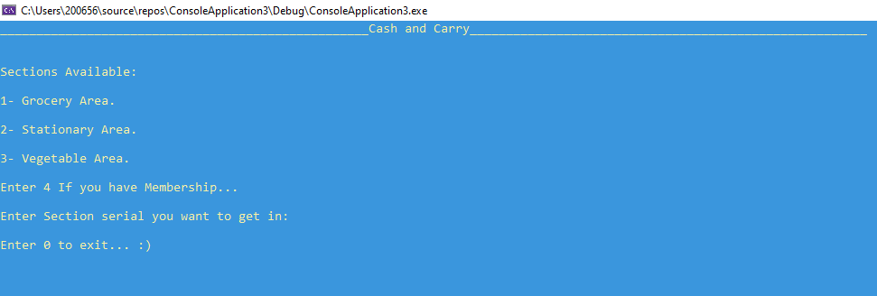

Slide 10
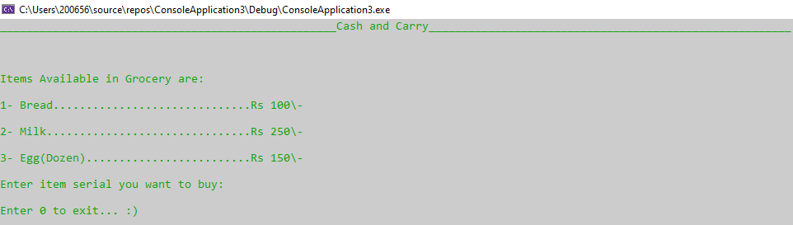

Slide 11
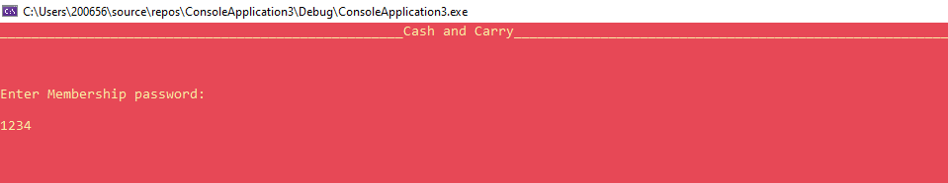

Slide 12
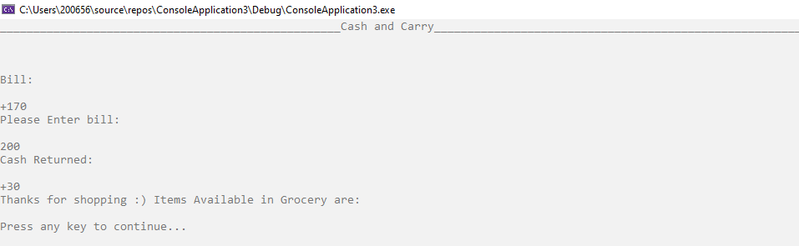

Slide 13
Thank You

